Slide 1

Functions
Defining and Using Functions
SoftUni Team
Technical Trainers
Software University
https://softuni.bg

Slide 2
Have a Question?
sli.do
#cpp-fundamentals
Notes:
2

Slide 3
Table of Contents
What is a Function
Declaring vs. Defining
Functions with Parameters
Returning Values from Functions
Static Variables Inside Functions
Value vs. Reference Types
3
Notes:
3

Slide 4
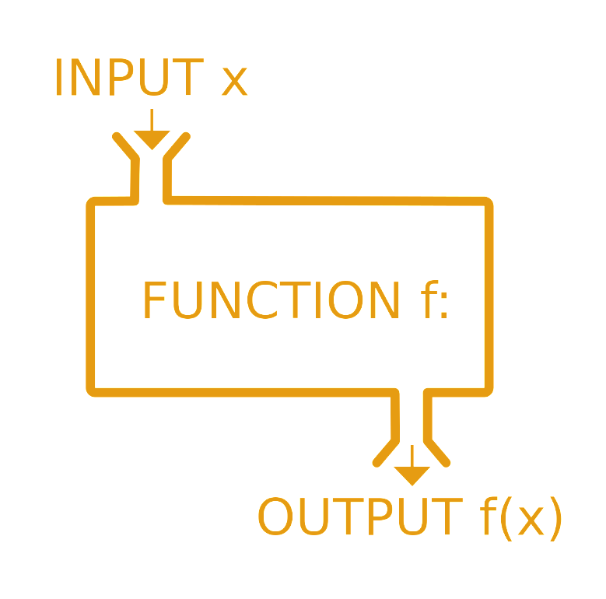
Functions
Calling, Defining, Implementing

Slide 5
What is a Function?
Named block of code, that performs a specific task
Can take parameters and return a value
Sample function definition:
Also known as methods (when in classes)
main() is a function
Function named printHelloWorld
void printHelloWorld ()
{
cout << "Hello World!" << endl;
}
Function body always surrounded by { }

Slide 6

Why Use Functions?
More manageable programming
Splits large problems into small pieces
Better organization of the program
Improves code readability
Improves code understandability
Avoiding repeating code
Improves code maintainability
Code reusability
Using existing methods several times

Slide 7
Declaring and Calling Functions
{…}
Notes:
Add Image!

Slide 8
Declaring Functions
Declaration – function's name, return type and parameters
Can be separate from definition (which includes the code block)
Parameters: empty, single or several separated by ,
Type
Function name
Parameters
void printNumber(int number)
{
cout << number << endl;
}
Function body

Slide 9

Calling Functions
Using functions is almost like using variables, however:
You write () after them, which could contain parameters
Most functions return a value – you can use it in an expression
void functions don't have values
void helloWorld()
{
cout << "Hello World!" << endl;
}
int main()
{
helloWorld();
return 0;
}

Slide 10
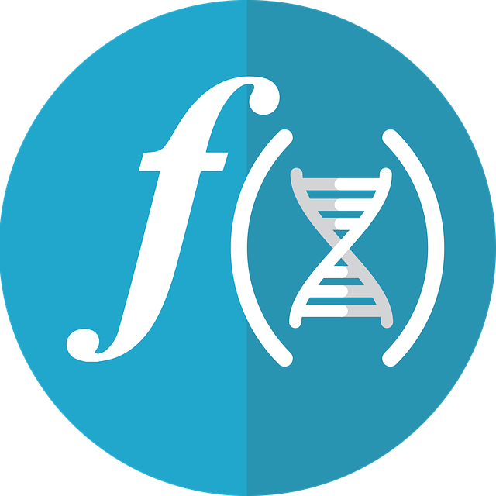
Declaring vs. Defining Functions

Slide 11
Declaring vs Defining Functions
Declaration – tells the compiler there is certain a function
Can be anywhere
Can appear multiple times
Same visibility rules as for variables
Definition – function's execution
#include<iostream>
using namespace std;
void helloWorld();
int main()
{
helloWorld();
return 0;
}
void helloWorld()
{
cout << "Hello World!" << endl;
}

Slide 12
Functions with Parameters
string
uint
long
byte
short
ulong
ushort
int
sbyte

Slide 13
Function Parameters
Function parameters can be of any data type
Parameters are just variables used in the function's block
Call the function with certain values (arguments)
void printNumbers(int start, int end)
{
for (int i = start; i <= end; i++)
{
cout << i << endl;
}
}
Multiple parameters separated by comma
int main()
{
printNumbers(5, 10);
return 0;
}
Passing arguments when called

Slide 14
Parameters and Default Values
Parameters with default values can be omitted by the caller
#include <iostream>
using namespace std;
void countNumbers(int a = 1, int b = 10)
{
for (int i = a; i <= b; i++)
{
cout << i << endl;
}
}
int main()
{
countNumbers();
return 0;
}

Slide 15
Returning Values from Functions

Slide 16
Returning Values from Functions
The return keyword immediately stops the function's execution – early exit
Returns the specified value
Non-void functions must have a return followed by a value
int getMax(int a, int b)
{
if (a > b)
{
return a;
}
return b;
}

Slide 17
Using the Return Values
Return value can be:
Assigned to a variable:
Used in expression:
int max = getMax(5, 10);
double total = getPrice() * quantity * 1.20;

Slide 18

Overloading Functions

Slide 19

Overloaded Functions
Using the same function name and return type but with different parameter list
int getMax(int a, int b)
{
if (a > b)
{
return a;
}
return b;
}
int getMax(int a, int b, int c)
{
return getMax(a, getMax(b, c));
}

Slide 20

Static Variables Inside Functions

Slide 21
static Variables Inside Functions
static variables live through entire program, initialized once
static variables can be used inside functions to track state
void countNumbers(int a = 1, int b = 10)
{
static int num = 0;
for (int i = a; i <= b; i++)
{
cout << i << endl;
num++;
}
cout << "Static int -> " << num << endl;
}

Slide 22
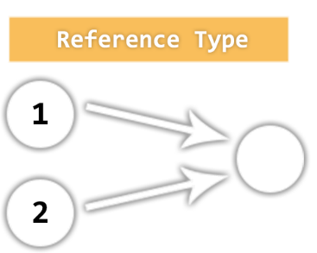
Value vs. Reference Types
Memory Stack and Heap

Slide 23
Value Types
Value type variables hold directly their value
int, float, double, bool, char…
Each variable has its own copy of the value
Stack
i
42
(4 bytes)
ch
A
(1 bytes)
int i = 42;
char ch = 'A';
bool result = true;
result
true
(1 byte)

Slide 24
Reference Types
Reference type variables hold а reference (pointer / memory address) of the value itself
Two reference type variables can reference the same variable
Operations on both variables access/modify the same data

Slide 25
Value vs Reference Types

Slide 26
Passing By Value vs. Passing By Reference
int square(int num)
{
num = num * num;
return num;
}
void swap(int& a, int& b)
{
int oldA = a; a = b; b = oldA;
}
int main()
{
int x = 5;
cout << square(x) << endl; //25
cout << x << endl; //5
int y = 42;
swap(x, y);
cout << x << endl; //42
return 0;
}
Parameters are normally copies of their originals
Passing by value
To access the caller's variables directly, use references
Syntax: DataType& param
Passing by reference

Slide 27

Summary
…
…
…
Break large programs into simple functions that solve small sub-problems
Functions consist of declaration and body
Functions are called by their name + ()
Functions can accept parameters
Functions can return a value or nothing (void)

Slide 28









Questions?

Slide 29













SoftUni Diamond Partners

Slide 30

License
This course (slides, examples, demos, exercises, homework, documents, videos and other assets) is copyrighted content
Unauthorized copy, reproduction or use is illegal
© SoftUni – https://about.softuni.bg/
© Software University – https://softuni.bg
Notes:
30

Slide 31
Trainings @ Software University (SoftUni)
Software University – High-Quality Education, Profession and Job for Software Developers
softuni.bg, about.softuni.bg
Software University Foundation
softuni.foundation
Software University @ Facebook
facebook.com/SoftwareUniversity
Software University Forums
forum.softuni.bg
Notes:
31

